Slide 1

Foundations of Artificial Intelligence: Core Concepts and Techniques
Welcome to an exploration of Artificial Intelligence, a field dedicated to creating systems that can reason, learn, and act with intelligence. This presentation provides an overview of the core concepts, historical approaches, and foundational algorithms essential for computer science students and early-career AI practitioners.

Slide 2



Defining Intelligence: What is AI?
Defining AI
The Turing Test
We begin with the core question: What constitutes artificial intelligence, and how do we measure it?
A historic and influential approach to defining and evaluating machine intelligence.
Measuring Intelligence: The Turing Test
The Turing Test, proposed by Alan Turing in 1950, suggested that if a machine could converse with a human judge and consistently deceive the judge into believing it was human, then it possesses intelligence. This approach focuses on the machine's ability to act like a human, emphasizing observable behavior over internal mechanisms.

Slide 3
Intelligent Agents and Rationality
In modern AI, the concept of an "agent" is central. An agent is anything that can be viewed as perceiving its environment through sensors and acting upon that environment through actuators. To be useful, these agents must strive for rationality.
Agents Defined
The Concept of Rationality
An AI agent is an entity that performs mapping from percept sequences to actions. They operate cyclically: perceive, process, and act.
A rational agent is one that acts correctly—it chooses the action that is expected to maximize its performance measure, given the percept sequence to date and its built-in knowledge.
Performance Measure
Omniscience vs. Rationality
A rational agent's success is measured by a performance measure, which determines what is desirable in the environment (e.g., maximizing profit, minimizing cost, or cleaning a floor efficiently).
An agent cannot be omniscient (knowing the actual outcome of its actions). Rationality deals with expected success given the available information, not guaranteed success.

Slide 4
Characterizing the Task Environment (PEAS)
To design a rational agent, we must first fully specify the task environment. AI uses the PEAS (Performance, Environment, Actuators, Sensors) framework to categorize and define the problem space.
Performance
Environment
Actuators
Sensors
The criteria for success.
The external world the agent operates in.
The mechanisms used to affect the environment (e.g., motors, displays).
The tools used to perceive the environment (e.g., cameras, microphones).
Key Properties of Task Environments
Task environments can be classified based on several critical properties, which dictate the complexity of the agent required:
Observable vs. Partially Observable: Can the agent see the entire state of the environment?
Deterministic vs. Stochastic: Is the next state entirely determined by the current state and the action executed?
Episodic vs. Sequential: Is the agent's experience divided into atomic episodes, or do current actions affect future decisions?
Static vs. Dynamic: Can the environment change while the agent is deliberating?
Discrete vs. Continuous: Are the states and time finite or infinite?

Slide 5

The Internal Architecture of AI Agents
The structure of an AI agent defines how it chooses actions based on its percepts and knowledge. Different problems require different levels of internal sophistication.
Simple Reflex Agent
Model-Based Reflex Agent
Acts based on the current percept, ignoring history. Fast but limited (e.g., a thermostat).
Maintains an internal state (a model) of the world to handle partial observability.
Goal-Based Agent
Utility-Based Agent
Uses goal information to decide which actions will lead to the desired future state (e.g., search algorithms).
Chooses actions that maximize its utility function, allowing for trade-offs between conflicting goals.
The Problem-Solving Agent
The Problem-Solving Agent is a specific type of goal-based agent that uses atomic representation (states and transitions) to find a sequence of actions that leads from the initial state to a goal state. This forms the basis for many classic AI problems.
The transition from a reflex agent to a goal-based agent often involves moving from simple conditional actions to complex search and planning.

Slide 6
Formulating Problems: Definition and Examples
A well-defined problem in AI consists of four components: the initial state, the set of actions (or successor function), the goal test, and the path cost function. Once formulated, we can apply search techniques.
Example Problem Types
These classic examples are essential for understanding and testing search algorithms:
Toy Problem: Vacuum World
8-Puzzle (Tile Sliding)
8 Queens Problem
A simple environment where the agent must clean dirty squares. Used to illustrate basic concepts of state, actions, and goal tests with minimal complexity.
Sliding tiles to arrange them into a goal configuration. Demonstrates the state-space search required for moderately complex problems and serves as a testbed for heuristics.
Placing eight queens on a chessboard so that no two queens attack each other. This is a classic example of a Constraint Satisfaction Problem (CSP) that can also be tackled with search.

Slide 7
Uninformed Search Strategies
Uninformed (or blind) search strategies use only the information available in the problem definition. They systematically explore the search space until the goal is found, without using any domain-specific knowledge about the location of the goal.
1
Breadth-First Search (BFS)
Explores all the nodes at one depth level before moving to the next level. Complete and Optimal (for unit costs), but high memory use.
2
Depth-First Search (DFS)
Always expands the deepest node in the current frontier. Low memory requirements, but neither complete nor optimal.
3
Depth-Limited Search (DLS)
DFS with a predefined depth limit L. Solves the incompleteness of DFS but sacrifices optimality if L is too low.
4
Iterative Deepening Search (IDS)
Repeatedly applies DLS, incrementing the limit L each time. Combines the optimality and completeness of BFS with the low memory overhead of DFS.
5
Bidirectional Search
Runs two simultaneous searches: one forward from the initial state and one backward from the goal state, meeting in the middle. Can significantly reduce time complexity.

Slide 8

Informed Search Strategies (Heuristic Search)
Informed search strategies leverage domain-specific knowledge (heuristics) to guide the search process, making them dramatically more efficient than uninformed methods for large search spaces.
Greedy Best-First Search
A* Algorithm
Hill Climbing Search
Expands the node that appears closest to the goal, as estimated by a heuristic function h(n). Fast but neither optimal nor complete.
The most widely used search algorithm. Evaluates nodes using f(n) = g(n) + h(n), where g(n) is the cost to reach the node and h(n) is the estimated cost to the goal. Complete and Optimal if the heuristic is consistent.
A local search technique that continuously moves in the direction of increasing value (uphill). Simple, but prone to getting stuck in local optima, plateaux, or ridges.
Local Beam Search
AND-OR Search
Keeps track of k states instead of one, initiating k parallel searches. At each step, it generates all successors of the k states and chooses the k best successors from the entire pool.
Used for problems where the solution involves a sequence of AND-OR steps, typically representing sub-problems that must be solved (AND) or choices between actions (OR).

Slide 9
Adversarial Search: Minimax and Pruning
When an agent must make decisions in an environment where another agent (the adversary) is trying to maximize its own utility (often at the expense of the first agent), we use adversarial search algorithms.
The Minimax Algorithm
Minimax is a recursive algorithm used for selecting an optimal move in two-player, zero-sum game theory. It explores the game tree to determine the optimal move for the current player, assuming the opponent plays optimally to minimize the current player's score.
MAX Player
Alpha-Beta Pruning
The maximizing player attempts to achieve the highest possible score.
Alpha-Beta pruning is an optimization technique for the Minimax algorithm that eliminates branches in the search tree. It stops evaluating a branch as soon as it determines that the branch cannot possibly contain the optimal move, significantly reducing the computation time without changing the result.
MIN Player
The minimizing player attempts to force the score to be as low as possible for the MAX player.

Slide 10


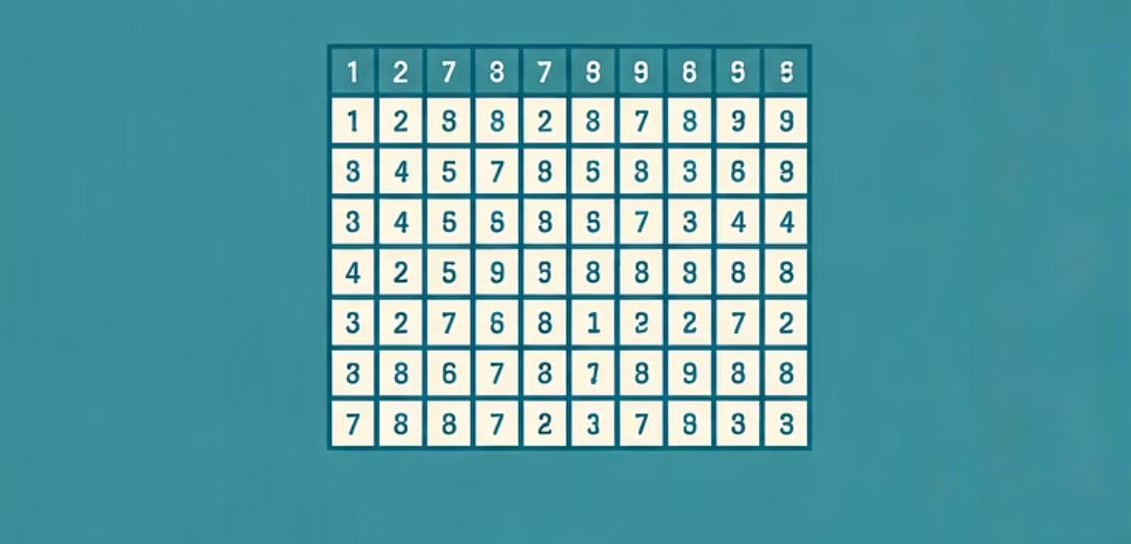
Classic AI Game Problems
Games provide an excellent environment for testing AI algorithms, as they involve structured rules, clear objectives, and often adversarial elements.
Tic-Tac-Toe
Chess
Sudoku
A simple, fully observable, deterministic game easily solved using Minimax, often used to introduce game theory concepts.
A complex, large-state space, zero-sum game requiring deep search (Minimax with Alpha-Beta Pruning) and advanced heuristics for move evaluation.
Not adversarial, but a pure Constraint Satisfaction Problem (CSP) involving high complexity and requiring backtracking search or specialized CSP solvers.

Slide 11
Constraint Satisfaction Problems (CSPs)
CSPs involve finding a state in which every variable satisfies a set of constraints. They are typically defined by a set of variables, a domain for each variable, and a set of constraints between the variables.
Cryptarithmetic Puzzle Example
A famous CSP where letters must be replaced by digits (e.g., SEND + MORE = MONEY). This problem perfectly demonstrates the application of CSP techniques like backtracking and heuristics.
Local Consistency
Techniques like arc consistency (AC-3) remove inconsistent values from the domains of variables, reducing the search space before and during search.
Bound Propagation
In CSPs with continuous variables, propagation ensures that constraints on boundaries (ranges) are respected, narrowing the possible solution space.
Backtracking Search
The primary algorithm for CSPs. It assigns values one variable at a time, checking for constraint violations. If a violation occurs, it backtracks to the previous variable.
Heuristics for Backtracking
Minimum Remaining Values (MRV)
Degree Heuristic
Chooses the variable with the fewest legal remaining values (the most constrained variable) to detect failures early.
Ties broken by choosing the variable involved in the largest number of constraints on unassigned variables.

